Slide 1
Floating-Point Fused Multiply-Add Architectures
Ph.D. Dissertation of Eric Quinnell, AMD/UT
May 1, 2007
Supervisor:
Dr. Earl E. Swartzlander, Jr., The University of Texas at Austin

Slide 2
Outline
Introduction to fused multiply-add (FMA)
History
Benefits/Problems
Methods
Results-I: Three-Path FMA
Results-II: Bridge FMA
Conclusion
Publications

Slide 3
The Floating-Point Fused Multiply-Add
IBM RS/6000 – R. Montoye, E. Hokenek, S. L. Runyon – Austin, TX, 1990
Executes in a single unit the equation:
D = (A x B) + C
Invented to accelerate dot-product calculations
Combines floating-point adder (FPA) and floating-point multiplier (FPM) in a single hardware block for increased performance
Higher precision – only one round stage
May entirely replace FPA & FPM
  FPA: (A x 1.0) + C
  FPM: (A x B) + 0.0

Slide 4
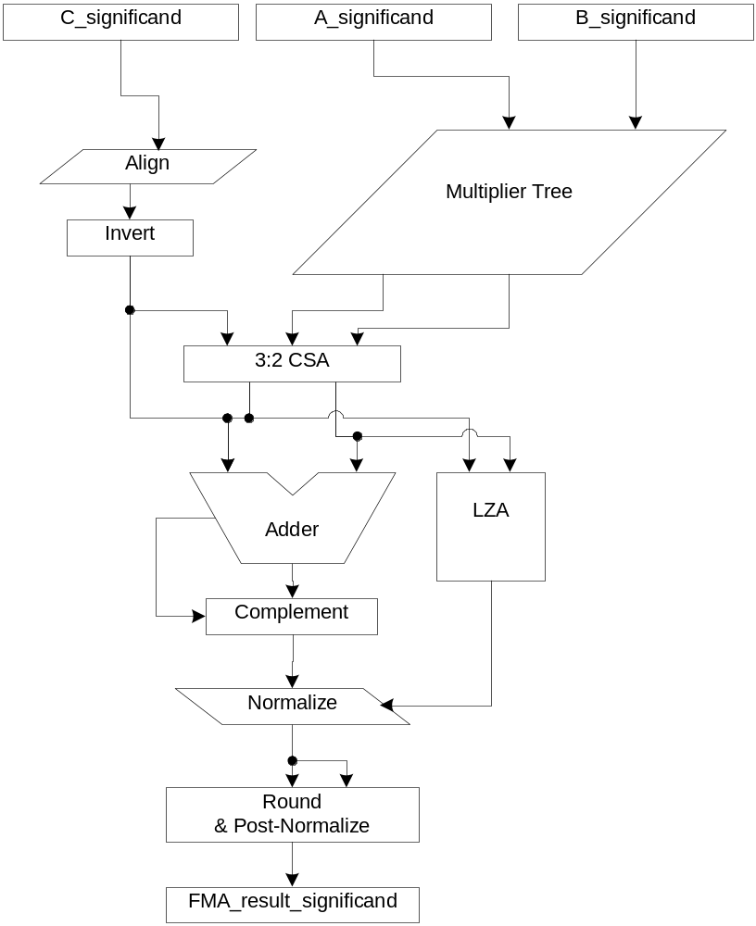
“Classic” FMA
IBM RS/6000 architecture
Serial implementation of multiply followed by add
Intermediate bit-range roughly equal to 3 x the data-type significand
  SP SSE: 74-bits
  DP SSE: 161-bits
  EP/x87: 194-bits
Complement stage/end-around carry (EAC) adder required for zero cross-over

Slide 5
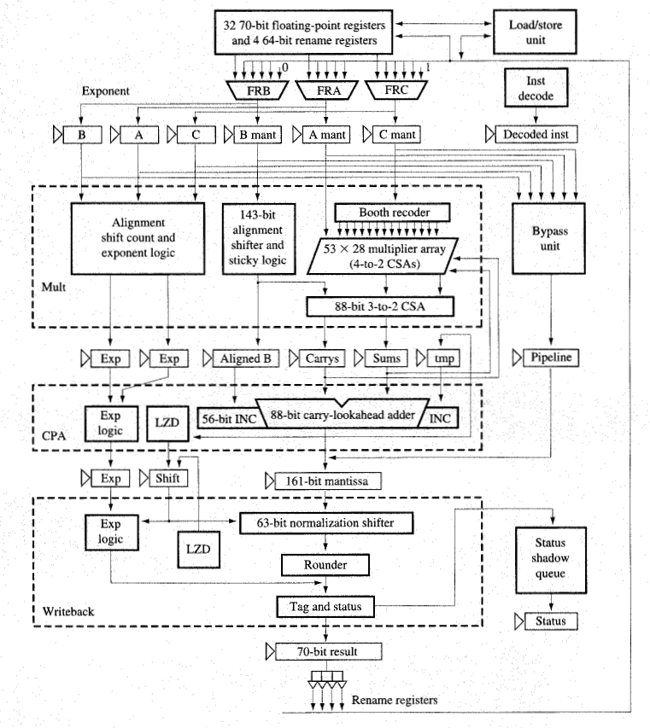
Implementation Variant
IBM PowerPC 603e
Jessani, Putrino, Olson, IBM 1996,1998
Iterative mul/add stages for SP acceleration, area/power savings
Slower DP due to iteration
EAC adder (best early description in an FMA)

Slide 6
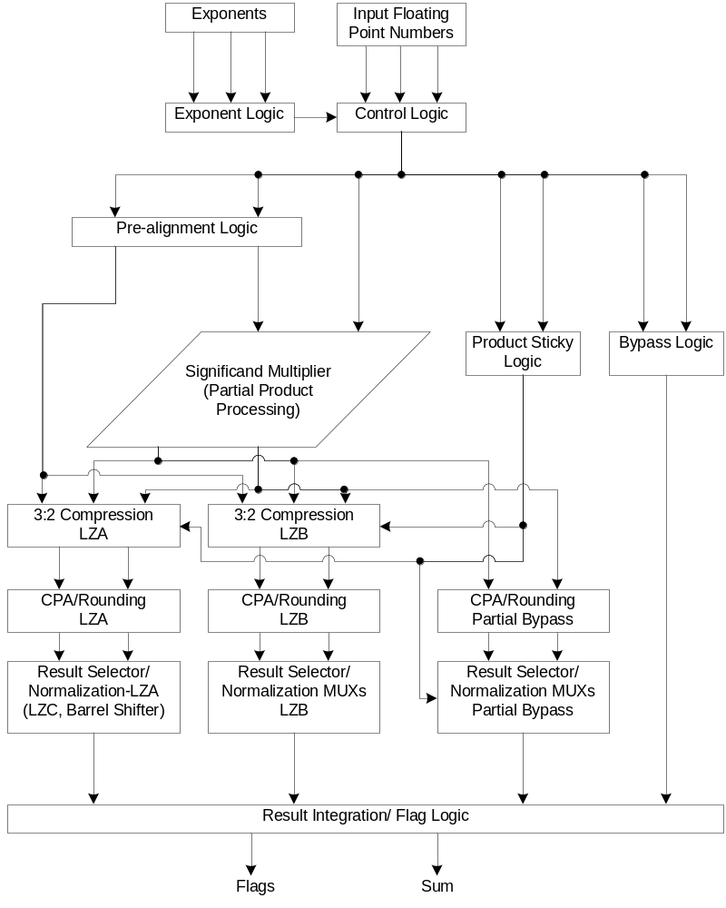
Implementation Variant
Concordia FMA
Pillai, Shah, Al-Khalili, and Al-Khalili, 2001
Built for power savings, turning off unused logic
Early exit point for FPM
DSP application specific – loses precision via truncated product
  Aligner before MUL
FPA dual-path style split

Slide 7
Additional Variants
“Psuedo” FMA – HAL SPARC 64 – Naini, Dhablania, James, and Das Sarma, 2001.
  Bus directly connecting FPM to FPA
Reduced Latency FMA – T. Lang and J.D. Bruguera, 2002, 2004
  Combine addition and rounding stage
  Theoretical design, archaic LZA
Multiple Path – Peter-Michael Seidel, 2003
  5 major data corners, split according to verification cases
  FPA dual-path style theoretical implementation
FMA with embedded FPA – T. Lang and J.D. Bruguera, 2005
  Reduced latency FMA architecture
  New “close path” (dual-path) for handling FPA cases
  Theoretical design

Slide 8
Industrial History
(A x B) + C now used in DSP, graphics, FFT, multimedia, transcendentals, division, FIR, etc…
IEEE-754 revision committee adding FMA to the standard – will require industrial support of FMA instruction
IBM – RS/6000, PowerPC 603/604, POWER3,4,5,…
HP – PA-8000, 8100,…8900
MIPS R10000
ARM VFP10
Intel Itanium, Itanium2
ATI R6xx
ALL industry chips use the IBM RS/6000 architecture

Slide 9
Benefits/Problems
FMA Benefits vs. FPA + FPM
Reduced latency for FMA instructions
Higher precision (only one round stage)
Can entirely replace FPA, FPM
Less area than FPA + FPM
Problems vs. FPA + FPM
Increased latency for FPA, FPM instructions
Massive components (i.e., EP/x87 requires 194-bit align, EAC adder, LZA, and normalize structure)
Power hungry
Reduced throughput
3-operand instructions – requires completely new FP unit support (scheduler, RD/WR ports, etc.)
Verification nightmare

Slide 10
The Project
Aimed at the design and implementation of new architectures to fix the major drawbacks in FMA units without degrading the benefits
Academic research conducted with the resources provided by UT Austin
Design and implementation industrial tools licensed by Advanced Micro Devices in 65nm SOI

Slide 11
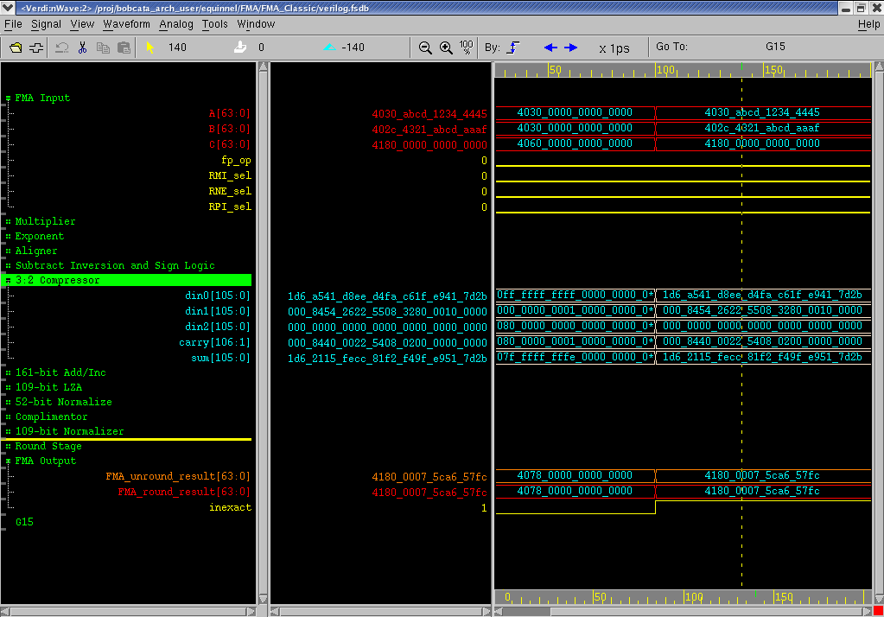
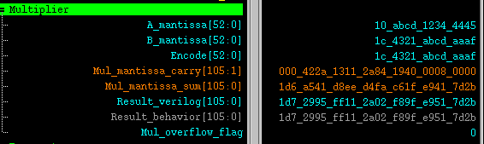
Methods
AMD 65nm SOI gha_stdcell (Barcelona) library
AMD AXE implementation flow rel. 6/30/2006
Verilog RTL, VCS compiled, Debussy tested, vector and behavioral verification

Slide 12
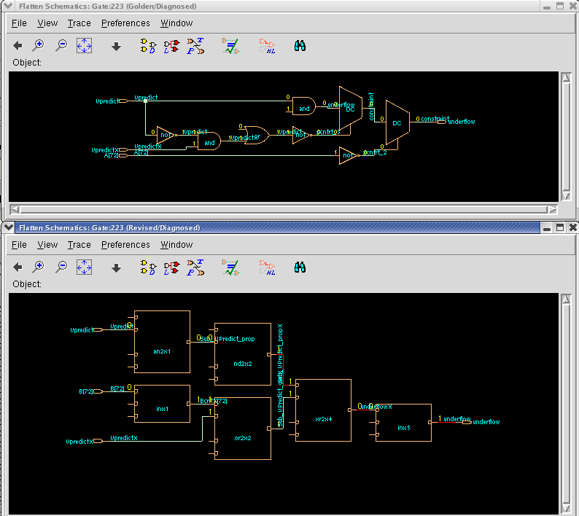
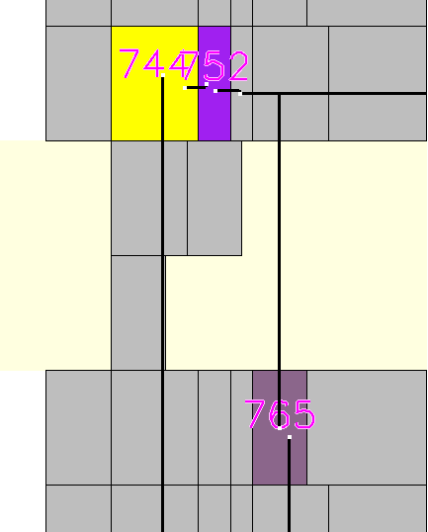
Methods
Custom (hand) reduction to gate-level Verilog, custom placement in AXE PX/VP
Designs timed and optimized in AXE ESPF (Steiner route) extractions
RTL to Gate verification via Verplex LEC

Slide 13
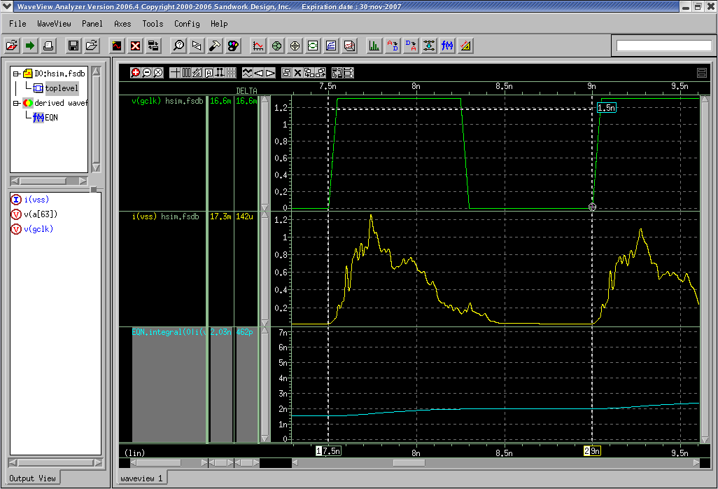
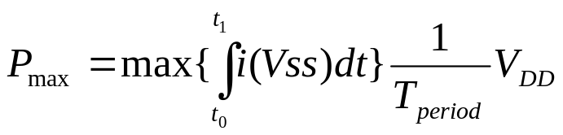
Methods
HSim random-input power simulations
Max power selected to show absolute worst-case minimum gains of new FMA architectures
Frequency normalized to slowest block

Slide 14
Results-I: Three-Path FMA
The three-path FMA architecture uses three parallel data paths to reduce latency and power consumption
Parallel paths allow data to skip prediction stages based on the data-range
Data “anchoring” is used for parallel cases, removing complementation
Elimination of massive components—specifically targeting the aligner and EAC adder
Shut down unused paths for power savings – only 1 of 3 paths is ever active

Slide 15
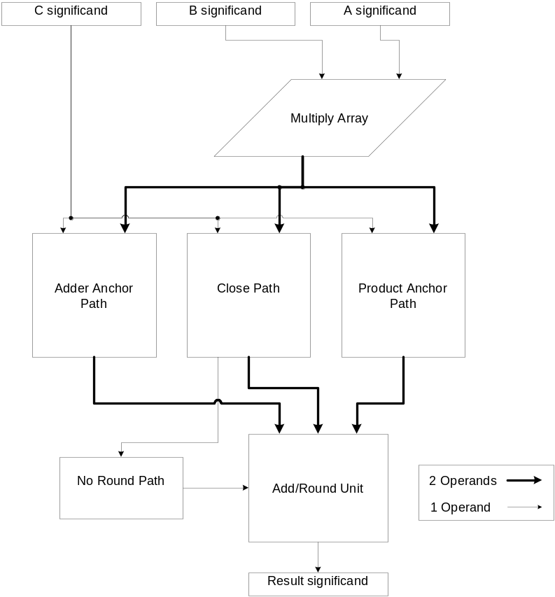
Three-Path FMA
Adder Anchor Path – locks position of addend for FMAs with larger addends
Product Anchor Path – locks position of product for FMAs with larger products
Close Path – for massive cancellation cases
Combined add/round unit with no-round path option
Standard multiplier array

Slide 16
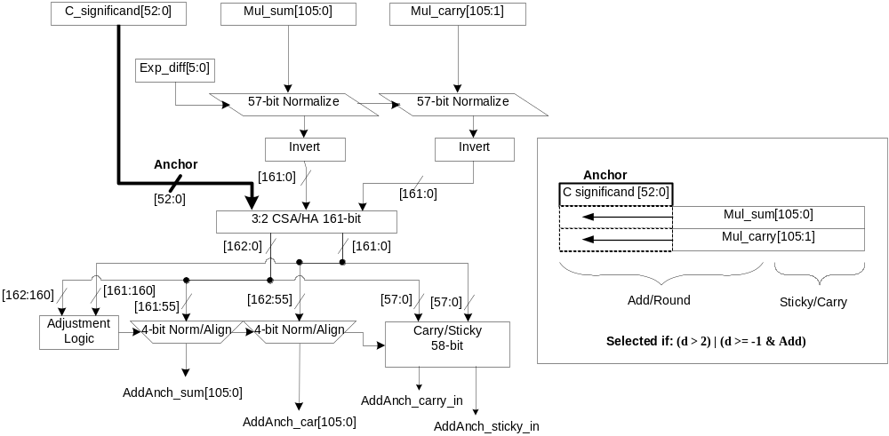
Three-Path FMA – Adder Anchor Path

Slide 17
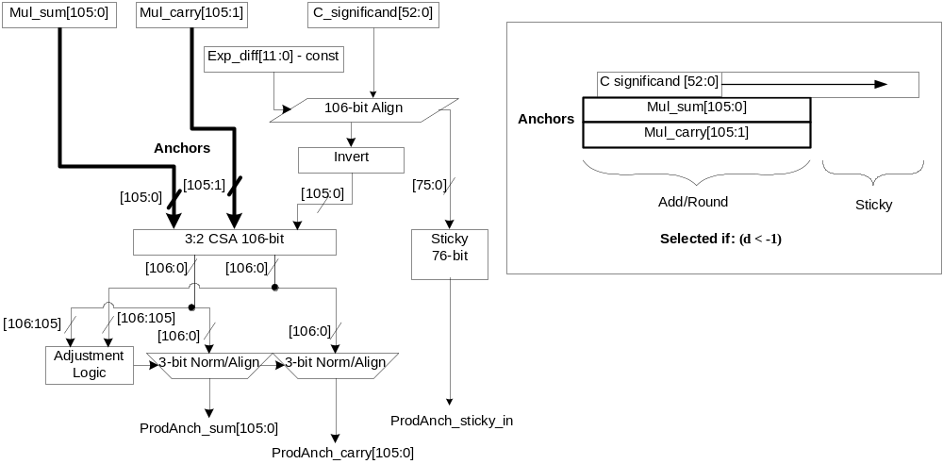
Three-Path FMA – Product Anchor Path

Slide 18
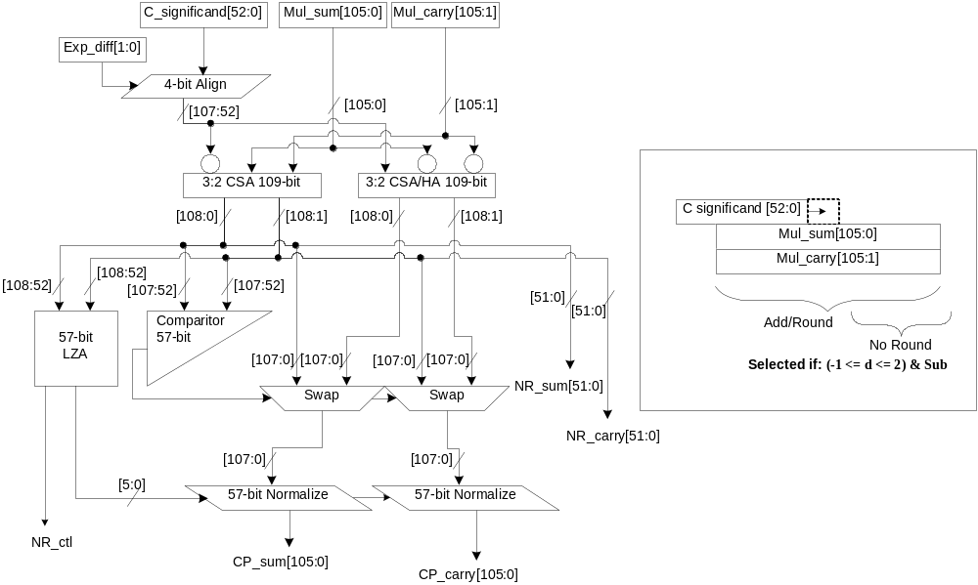
Three-Path FMA – Close Path

Slide 19
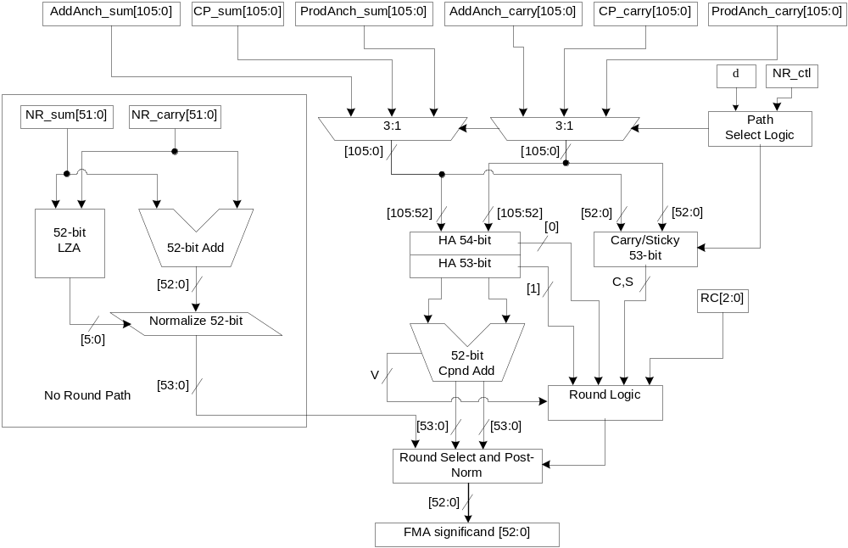
Three-Path FMA – Add/Round

Slide 20
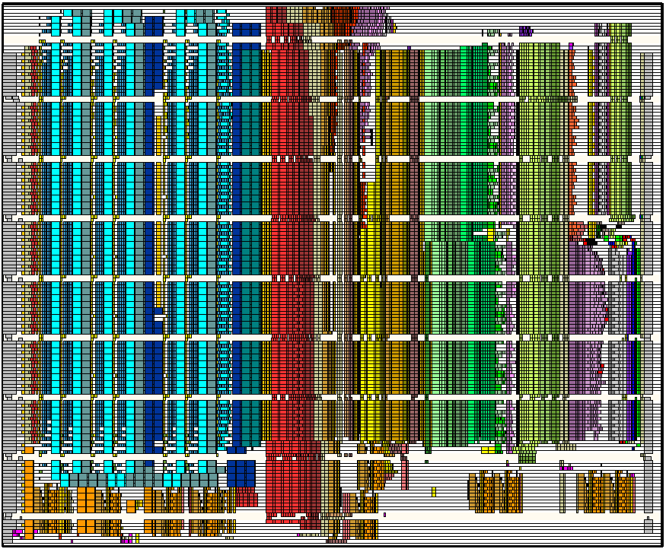
Three-Path FMA VP/PX view

Slide 21
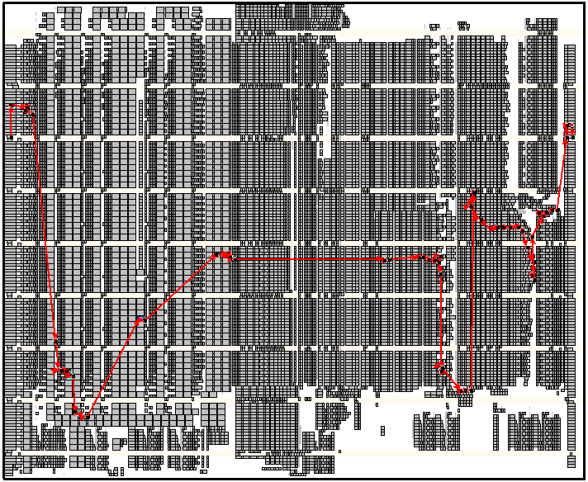
Three-Path FMA VP/PX crit path

Slide 22
Three-Path FMA Results
The three-path FMA architecture shows about a 12% reduction in latency and 15% reduction in maximum power consumption compared to a classic FMA architecture
These gains come at the cost of 40% more area
Design
Latency
1.3V 100°C
TypVt
Latency
0.7V 100°C LowVt
Area
65nm AMD SOI
Power (max)
666 MHz 1.3V TypVt
Classic FMA
1224ps
3363ps
186,930μm²
416mW
Three-Path FMA
1081ps
2959ps
259,005μm²
354mW
Difference
–11.7%
–12.0%
38.6%
–14.9%

Slide 23
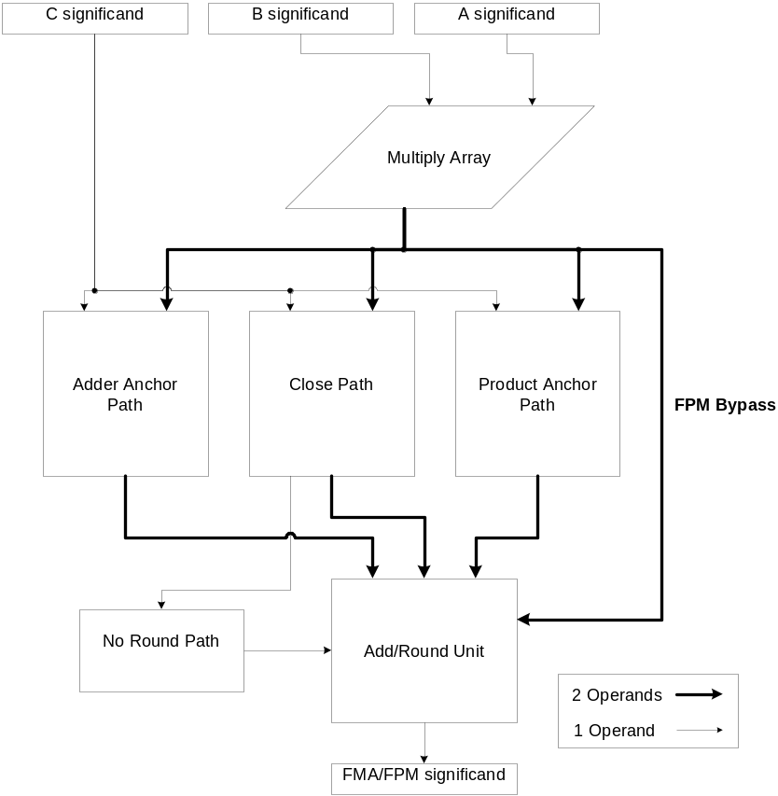
Three-Path FMA – Additional Benefits
Full performance single-instruction FPMs built-in to architecture
Full performance single-instruction FPAs possible in future work
Localized logic/wiring less affected by technology shrinks

Slide 24
Results-II: Bridge FMA
The bridge FMA architecture re-uses already built FPA and FPM components to provide FMA functionality to common x87 designs
Allow full performance FPA instructions with no FMA interruptions
Allow full performance FPM instructions with no FMA interruptions
Allow single-instruction parallel execution
Connects FPM multiplier tree with FPA add/round unit in an FMA “bridge”
Addend comes from adder pipeline
Does not require FPU overhaul

Slide 25
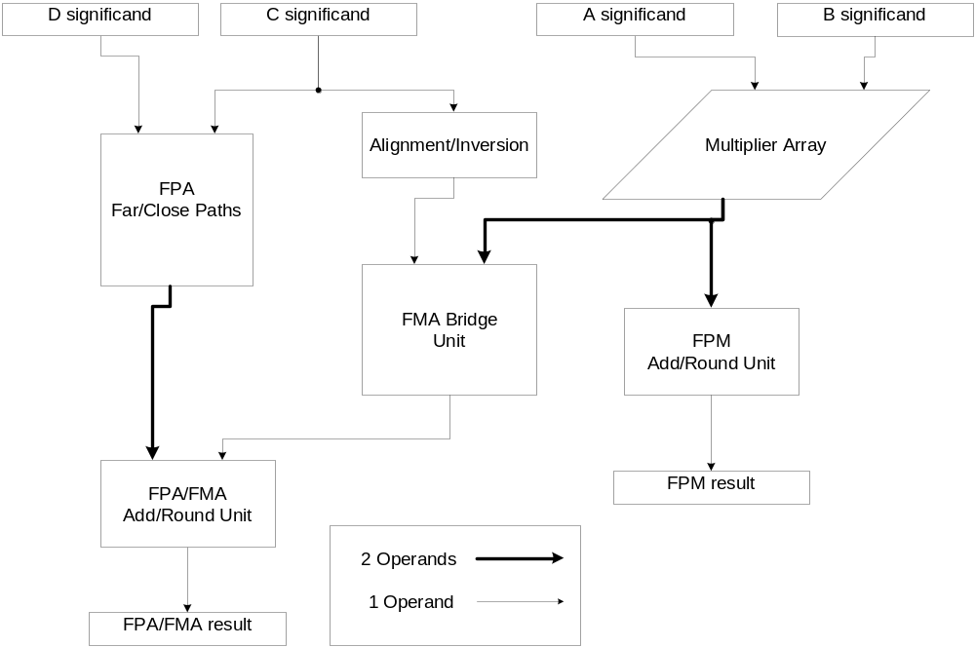
Bridge FMA

Slide 26
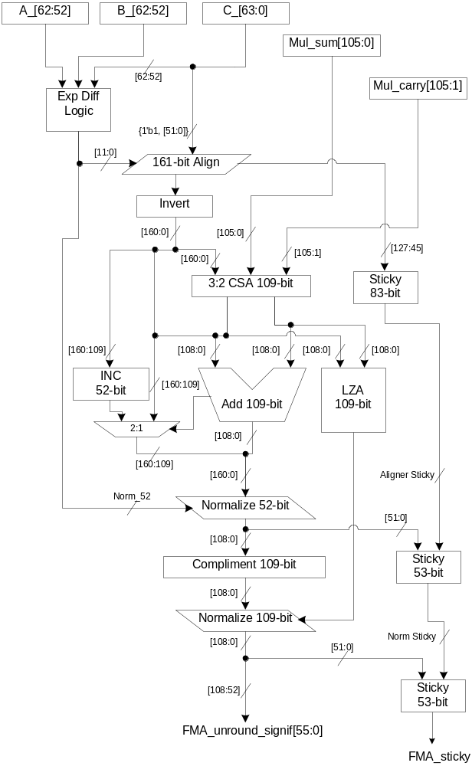
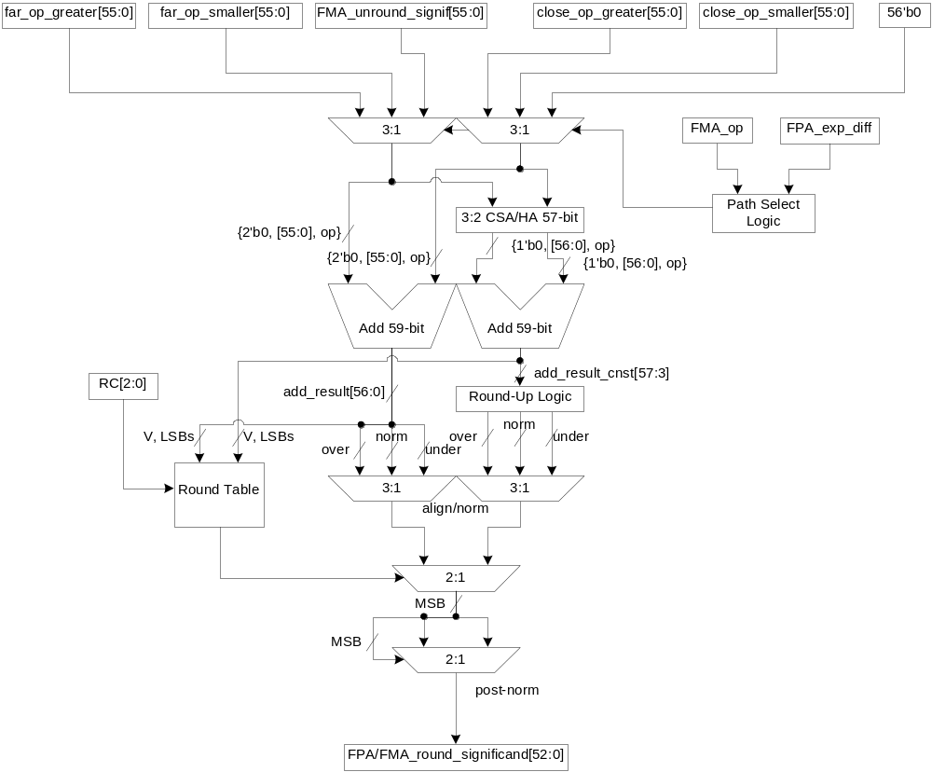
Bridge FMA
Add/Round Unit
Bridge Unit

Slide 27
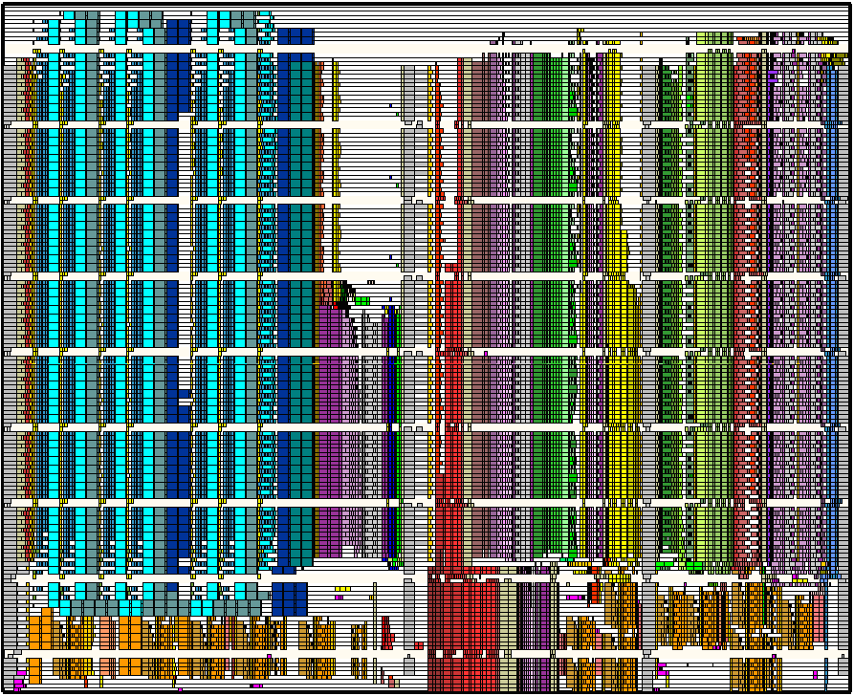
Bridge FMA VP/PX View

Slide 28
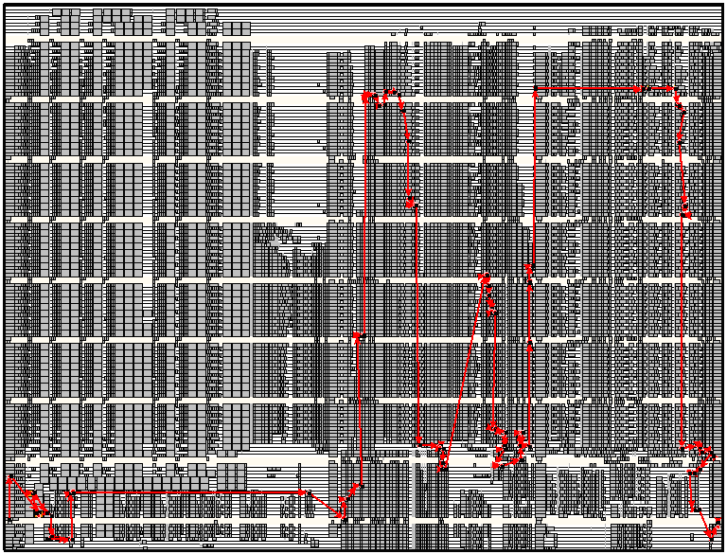
Bridge FMA VP/PX crit path

Slide 29
Bridge FMA – Results
Design
Latency
1.3V 100°C RVT
Latency
0.7V 100°C LVT
Area
65nm AMD SOI
Peak Power
666 MHz 1.3V RVT
FPA_DP
946ps
2556ps
72,075μm²
118mW
FPM_DP
701ps
1950ps
131,130μm²
187mW
Classic FMA
1224ps
3363ps
186,930μm²
416mW
Bridge FMA
FPA: 978ps
FPM: 708ps
FMA: 1454ps
FPA: 2625ps
FPM: 1979ps
FMA: 3973ps
283,650μm²
FPA: 118mW
FPM: 187mW
FMA: 501mW
Design
Latency 1.3V 100 ˚C RVT
Latency 0.7V 100 ˚C LVT
Area
65nm AMD SOI
Power
666 MHz 1.3V RVT
FPA
0%
0%
0%
0%
Classic FMA Δ
29.4%
31.6%
159.4%
252.5%
Bridge FMA Δ
3.4%
2.7%
293.6%
0%

Slide 30
Bridge FMA – Results
Design
Latency 1.3V 100 ˚C RVT
Latency 0.7V 100 ˚C LVT
Area 65nm AMD SOI
Power
666 MHz 1.3V RVT
FPA + FPM
0%
0%
0%
0%
Classic FMA Δ
-25.7%
-25.4%
-8%
36.4%
Bridge FMA Δ
-11.7%
-11.8%
39.6%
64.3%
Design
Latency 1.3V 100 ˚C RVT
Latency 0.7V 100 ˚C LVT
Area
65nm AMD SOI
Power
666 MHz 1.3V RVT
FPM
0%
0%
0%
0%
Classic FMA Δ
74.6%
72.5%
42.6%
122.5%
Bridge FMA Δ
1.0%
1.5%
116.3%
0%

Slide 31
Results – All FMAs
Design
Latency vs RS/6000
Power
vs RS/6000
Implemented or Theoretical
Numerically Correct?
Max-performance FPM?
Max-performance FPA?
IBM RS/6000 [1],[2]
N/A
N/A
Implemented
Yes
No
No
IBM PowerPC 604e [12],[13]
faster SP, slower DP
½ size Mul tree
Implemented
Yes
No
No
HAL SPARC64 (pseudo-FMA) [21]
slower
N/A
Implemented
rounded twice
Yes
Yes
Concordia FMA [22]
-9%
-44%
Implemented
No
Yes
No
Lang/Bruguera [23]
-(15-20%)
N/A
Theoretical
Yes
No
No
Seidel Multi-Path [28]
-30%
N/A
Theoretical
unclear
No
No
Xiao-Lu LZA improvement of Lang/Bruguera [30]
-(15-20%) - (0.17 x LZA)
N/A
LZA Implemented, FMA Theoretical
Yes
No
No
Lang/Bruguera w/ FPA bypass [32]
-10%
N/A
Theoretical
Yes
No
No†
Three-Path FMA
-12%
-15%
Implemented
Yes
Yes
No
Bridge FMA
20%
20%
Implemented
Yes
Yes
Yes
† 40% faster floating-point add performance as compared to a classic FMA execution of the same

Slide 32
Conclusion
Industry-wide FMA use is inevitable. Support for FMA instructions is becoming necessary via graphics, multimedia, SSE, and the upcoming IEEE-754r.
Implementing an FMA unit using the IBM RS/6000 architecture is risky since it reduces legacy code performance, requires an FPU overhaul, and increases in timing difficulty as technology scales
The Three-Path FMA design reduces power consumption and latency in an architecture suited for technology scaling, while allowing full-performance FPM instructions and a future design expansion for full-performance FPA instructions
The Bridge FMA design provides FMA functionality in a standard floating-point unit, while allowing full-performance single-instructions to execute in parallel
The new FMA designs are intended to provide design options to satisfy application needs

Slide 33
Publications
Journal Papers
Conference Papers
Patents
E. Quinnell, E. E. Swartzlander, Jr. and C. Lemonds, “A Three-Path Floating-Point Fused Multiply-Add Design,” submitted to IEEE Transactions on Computers, April 2007.
E. Quinnell, E. E. Swartzlander, Jr. and C. Lemonds, “Bridged Floating-Point Fused Multiply-Add Design,” submitted to IEEE Transactions on VLSI Systems, April 2007.
E. Quinnell, E. E. Swartzlander, Jr. and C. Lemonds, “Floating-Point Fused Multiply-Add Architectures,” The Fortieth Asilomar Conference on Signals, Systems, and Computers, 2007.
E. Quinnell, E. E. Swartzlander, Jr. and C. Lemonds, “Floating-Point Fused Multiply-Add Architectures,” U.S. Patent filed April 20, 2007.

Slide 34
References
[1] R.K. Montoye, E. Hokenek and S.L. Runyon, “Design of the IBM RISC System/6000 floating-point execution unit,” IBM Journal of Research & Development, Vol. 34, pp. 59-70, 1990.
[2] E. Hokenek, R. Montoye and P.W. Cook, “Second-Generation RISC Floating Point with Multiply-Add Fused,” IEEE Journal of Solid-State Circuits, Vol. 25, pp. 1207-1213, 1990.
[3] J. A. Davis, R. Venkatesan, A. Kaloyeros, M. Beylansky, S. J. Souri, K. Banerjee, K. C. Saraswat, A. Rahman, R. Reif and J. D. Meindl, “Interconnect Limits on Gigascale Integration (GSI) in the 21st Century,” Proceedings of the IEEE, Vol. 89, pp. 305-324, 2001.
[4] S. Natarajan and A. Marshall, “Technological Innovations to Advance Scalability and Interconnects in Bulk and SOI,” Proceedings of the 15th International Conference on VLSI Design, pp. 297-298, 2002.
[5] R.K. Krishnarnurthy, A. Alvandpour, V. De and S. Borkar, “High-Performance and Low-Power Challenges for Sub-70 nm Microprocessor Circuits,” Proceedings of the IEEE 2002 Custom Integrated Circuits Conference, pp. 125-128, 2002.
[6] C. Hinds, “An Enhanced Floating Point Coprocessor for Embedded Signal Processing and Graphics Applications,” Conference Record of the Thirty-Third Asilomar Conference on Signals, Systems, and Computers, pp. 147-151, 1999.
[7] Y. Voronenko and M. Puschel, “Automatic Generation of Implementations for DSP Transforms on Fused Multiply-Add Architectures,” International Conference on Acoustics, Speech and Signal Processing, pp. V-101- V-104, 2004.
[8] E. N. Linzer, “Implementation of Efficient FFT Algorithms on Fused Multiply-Add Architectures,” IEEE Transactions on Signal Processing, Vol. 41, pp. 93-107, 1993.
[9] A. D. Robison, “N-Bit Unsigned Division Via N-Bit Multiply-Add,” Proceedings of the 17th IEEE Symposium On Computer Arithmetic, pp. 131-139, 2005.
[10] R.-C. Li, S. Boldo and M. Daumas, “Theroems on Efficient Argument Reductions,” Proceedings of the 16th IEEE Symposium on Computer Arithmetic, pp. 129-136, 2003.
[11] F. P. O’Connell and S. W. White, “POWER3: The Next Generation of PowerPC Processors,” IBM Journal of Research and Development, Vol. 44, pp. 873-884, 2000.
[12] R. Jessani and C. Olson, “The Floating-Point Unit of the PowerPC 603e,” IBM Journal of Research and Development. Vol. 40, pp. 559-566, 1996.

Slide 35
References – 2
[13] R.M. Jessani and M. Putrino, “Comparison of Single- and Dual-Pass Multiply-Add Fused Floating-Point Units,” IEEE Transactions on Computers, Vol. 47, pp. 927-937. 1998.
[14] A. Kumar, “The HP PA-8000 RISC CPU,” IEEE Micro Magazine, Vol. 17, Issue 2, pp. 27-32, April, 1997.
[15] D. Hunt, “Advanced Performance Features of the 64-bit PA-8000,” Proceedings of Compcon, pp. 123-128, 1995.
[16] K. C. Yeager, “The MIPS R10000 superscalar microprocessor,” IEEE Micro Magazine, Vol. 16, No. 2, pp. 28-40, March, 1996.
[17] B. Greer, J. Harrison, G. Henry, W. Li and P. Tang, “Scientific Computing on the Itanium Processor,” Proceedings of the ACM/IEEE SC2001 Conference, pp. 1-8, 2001.
[18] H. Sharangpani and K. Arora, “Itanium Processor Microarchitecture,” IEEE Micro Magazine, Vol. 20, No. 5, pp. 24-43, Sept-Oct, 2000.
[19] DRAFT Standard for Floating-Point Arithmetic P754, IEEE Standard (proposed), Aug 18, 2006.
[20] IEEE Standard for Binary Floating-Point Arithmetic, ANSI/IEEE Standard 754-1985.
[21] A. Naini, A. Dhablania, W. James and D. Das Sarma, “1 GHz HAL Sparc64 Dual Floating Point Unit with RAS Features,” Proceedings of the 15th Symposium on Computer Arithmetic, pp.173-183.
[22] R.V.K. Pillai, S.Y.A. Shah, A.J. Al-Khalili and D. Al-Khalili, “Low Power Floating Point MAFs – A Comparative Study,” Sixth International Symposium on Signal Processing and its Applications, Vol. 1, pp. 284-287, August, 2001.
[23] T. Lang and J. D. Bruguera, “Floating-Point Fused Multiply-Add with Reduced Latency,” Proceedings of the 2002 IEEE International Conference on Computer Design: VLSI in Computers and Processors, pp. 145-150, 2002.
[24] N. Quach, N. Takagi and M. Flynn, On Fast IEEE Rounding, Technical Report CSL-TR-91-459, Stanford University, Jan. 1991.
[25] N. Quach and M.J. Flynn, An Improved Algorithm for High-Speed Floating Point Addition, Technical Report CSL- TR-90-442, Computer Systems Laboratory, Stanford University, Aug. 1990.
[26] G. Even and P. M. Seidel, “A Comparison of Three Rounding Algorithms for IEEE Floating-Point Multiplication,” IEEE Transactions on Computers, Vol. 49, pp. 638-650, 2000.

Slide 36
References – 3
[27] R. K. Yu and G. B. Zyner, “167 MHz Radix-4 Floating-Point Multiplier,” Proceedings of the 12th Symposium on Computer Arithmetic, pp. 149-154, 1995.
[28] P.-M. Seidel, “Multiple Path IEEE Floating-Point Fused Multiply-Add,” Proceedings of the 46th IEEE International Midwest Symposium on Circuits and Systems, pp. 1359- 1362, 2003.
[29] C. Jacobi, K. Weber, V. Paruthi and J. Baumgartner, “Automatic Formal Verification of Fused-Multiply-Add FPUs,” Proceedings of Design, Automation and Test in Europe, Vol. 2, pp. 1298-1303, March, 2005.
[30] M. Xiao-Lu, “Leading Zero Anticipation for Latency Improvement in Floating-Point Fused Multiply-Add Units,” 6th International Conference on ASIC, pp. 53-56, 2005.
[31] M.S. Schmookler and K.J. Nowka, “Leading Zero Anticipation and Detection – A Comparison of Methods,” Proceedings of the 15th IEEE Symposium on Computer Arithmetic, pp. 7-12, 2001.
[32] J.D. Bruguera and T. Lang, “Floating-Point Fused Multiply-Add: Reduced Latency for Floating-Point Addition,” Proceedings of the 17th IEEE Symposium on Computer Arithmetic. pp. 42-51, June, 2005.
[33] IEEE Standard for Verilog Hardware Description Language, IEEE Standard 1364 -2005.
[34] G. Dimitrakopoulos and D. Nikolos, “High-Speed Parallel-Prefix VLSI Ling Adders,” IEEE Transactions on Computers, Vol. 54, pp. 225-231, 2005.
[35] M. P. Farmwald, On the Design of High Performance Digital Arithmetic Units, Ph.D. thesis, Stanford University, 1981.

Slide 37
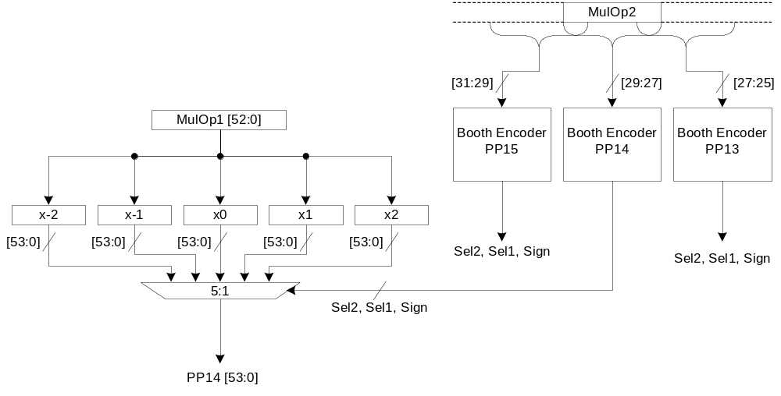
Radix-4 Mul
Table 3.3.1 Radix-4 Booth encoding for a multiplier tree
Input[2:0]
Booth Value
Sel2
Sel1
Sign
000
0
0
0
0
001
+1
0
1
0
010
+1
0
1
0
011
+2
1
0
0
100
-2
1
0
1
101
-1
0
1
1
110
-1
0
1
1
111
0
0
0
1

Slide 38
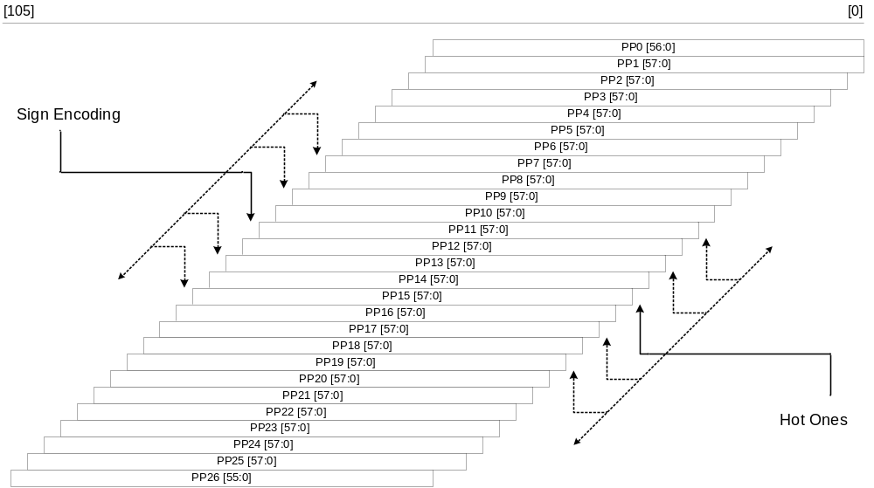
Radix-4 Mul
Table 3.3.1 Radix-4 Booth encoding for a multiplier tree

Slide 39
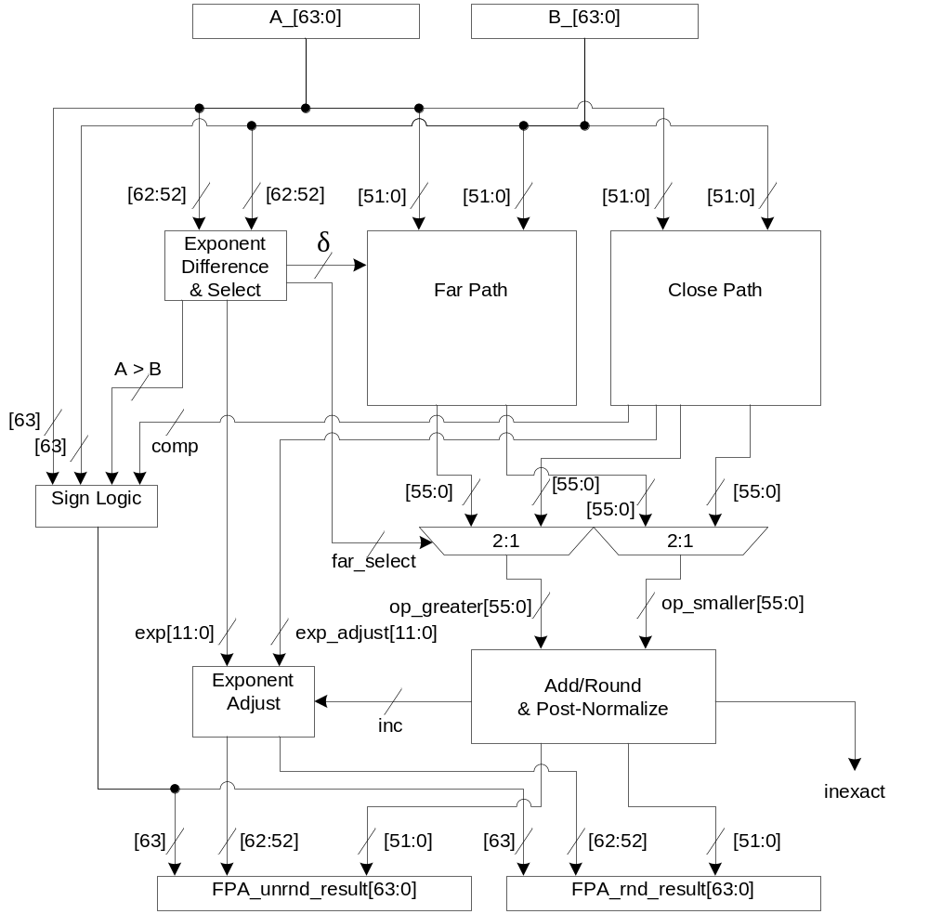
Floating-Point Adder
Table 3.3.1 Radix-4 Booth encoding for a multiplier tree

Slide 40
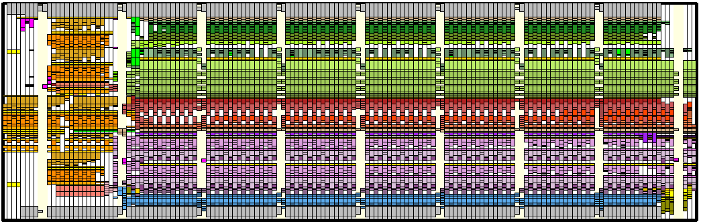
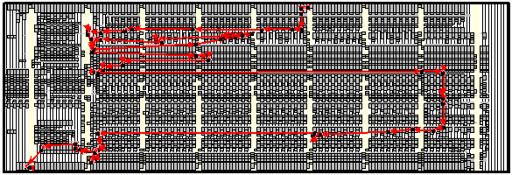
Floating-Point Adder
Table 3.3.1 Radix-4 Booth encoding for a multiplier tree

Slide 41
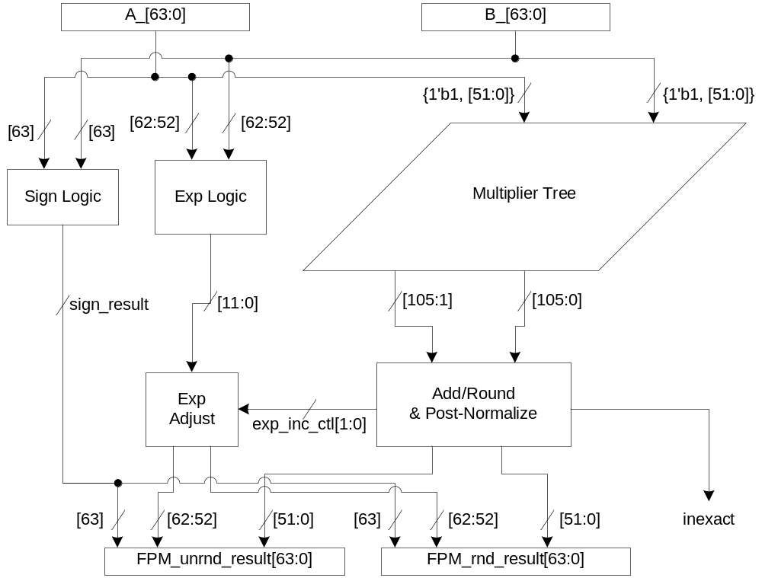
Floating-Point Multiplier
Table 3.3.1 Radix-4 Booth encoding for a multiplier tree

Slide 42
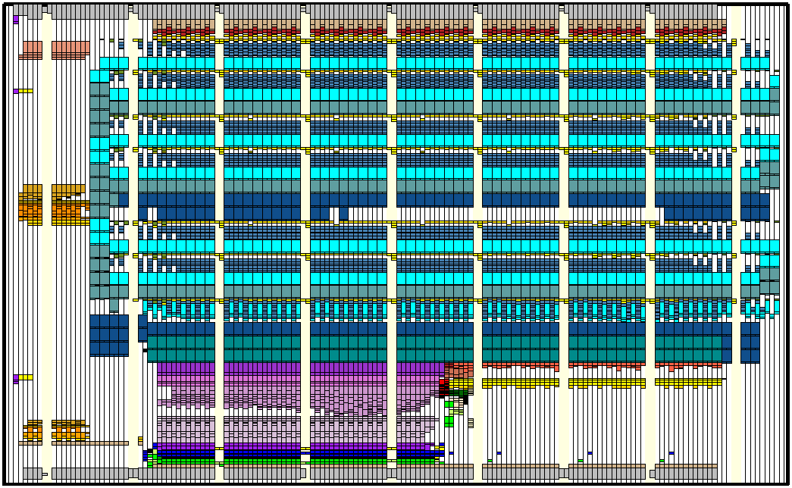
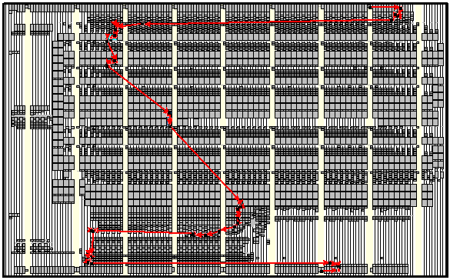
Floating-Point Multiplier
Table 3.3.1 Radix-4 Booth encoding for a multiplier tree

Slide 43
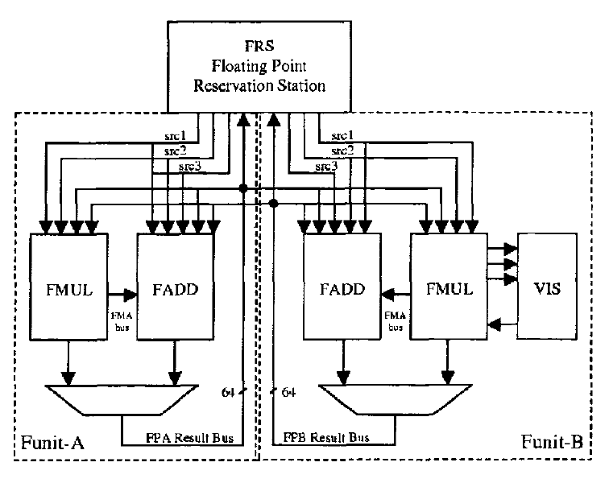
HAL SPARC-64

Slide 44
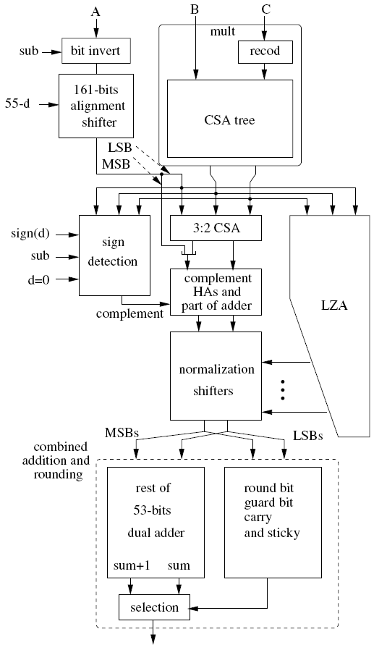
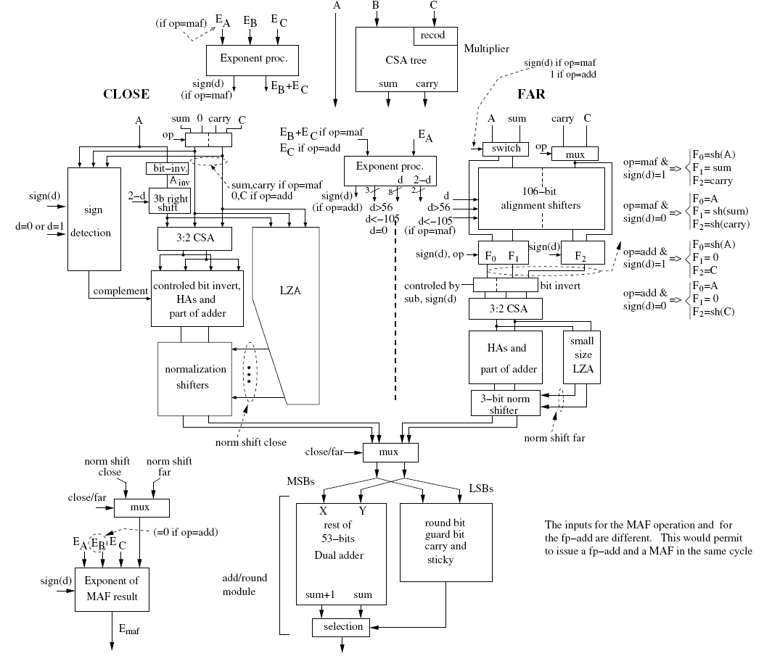
Lang/Bruguera

Slide 45
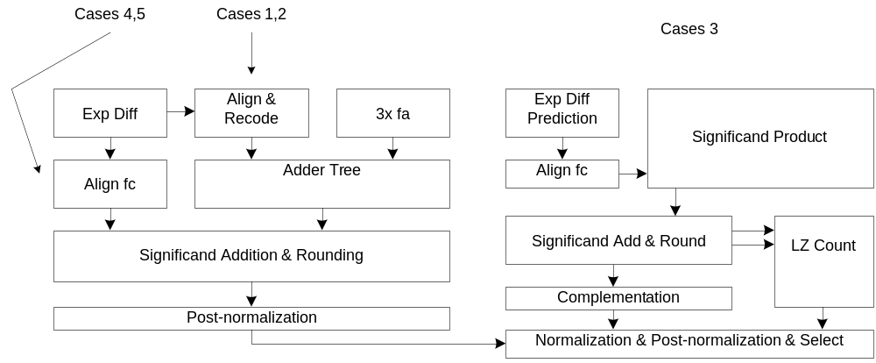
Seidel

